Slide 1

Christmas at St Andrew’s
Dates for your Diary

Slide 2

SCHOOL
CHRISTINGLE
TUESDAY 13TH
2PM
in Church

Slide 3

A Christmas Cracker!
Community
Carol Concert
with
School & Parish Choirs
Sunday 18th at 6pm

Slide 4

Into the Light!
A Blue Christmas Service
for those facing a
difficult Christmas
MONDAY 19TH 7PM

Slide 5

FREE FILM SHOW
TUESDAY 20TH
5.30pm in Church

Slide 6
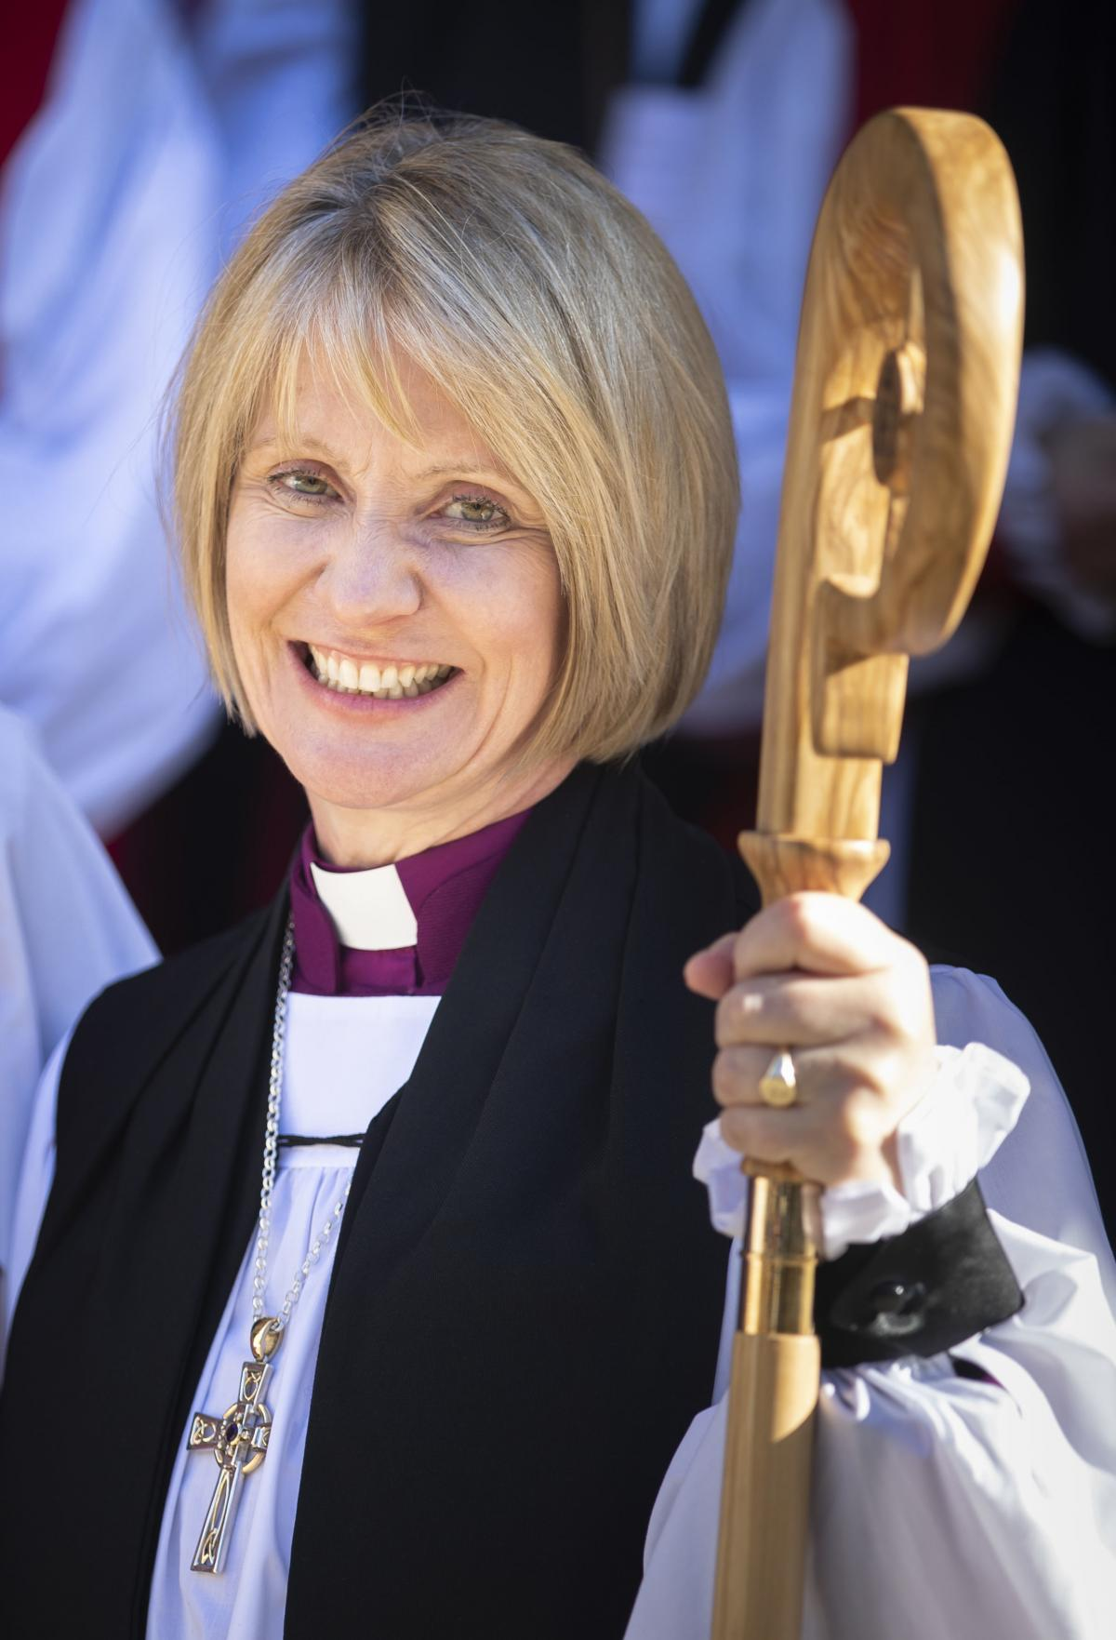

Meet the
Bishop of
Warrington
over
Christmas Coffee!
STONEMILL PUB Thurs 22nd at 11 AM

Slide 7
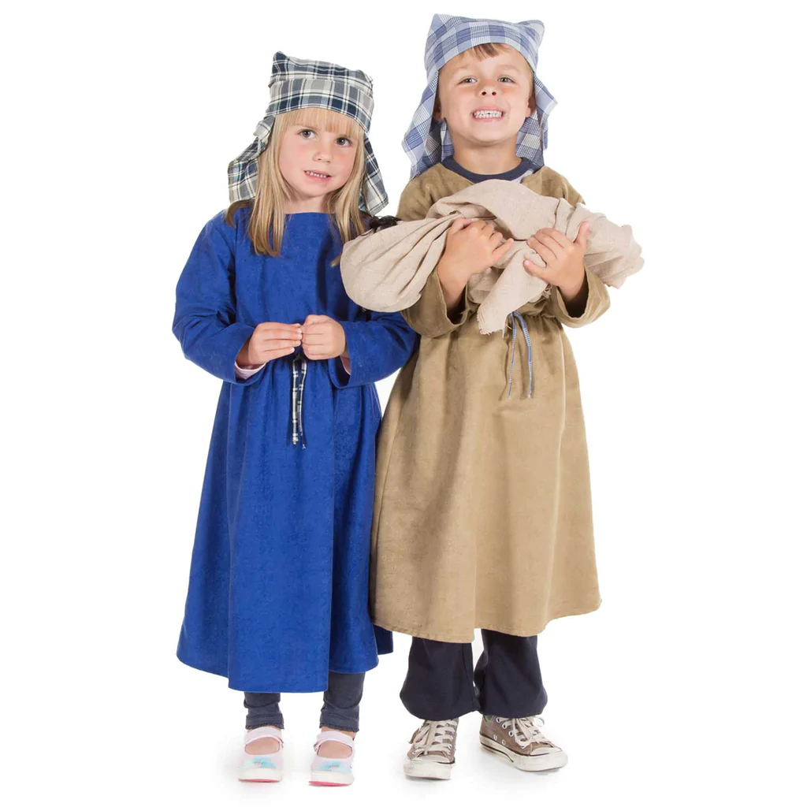

“All In” Nativity!
4pm Christmas Eve
Come dressed as
any Nativity Character

Slide 8

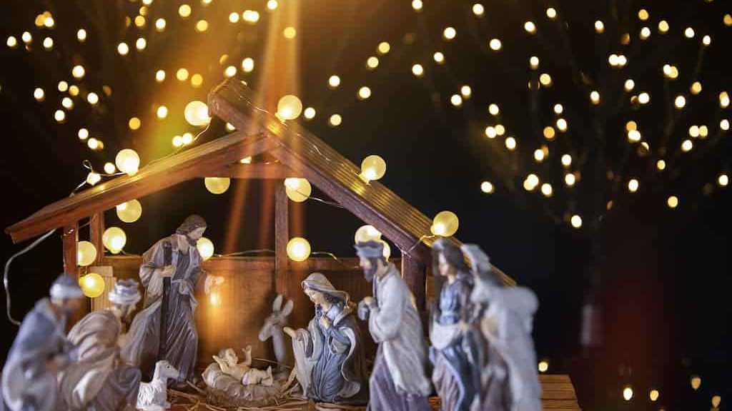
Celebrate
MIDNIGHT MASS
Here on
CHRISTMAS EVE
Starts 11.30pm

Slide 9

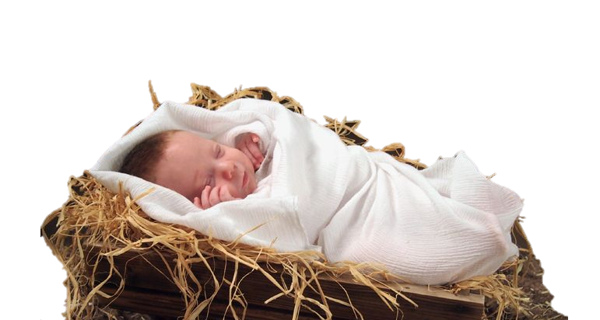
Christmas Day Family Eucharist
9.30am
with a very special guest!

